Slide 1
MPLS L3 VPN | LDP | Transport-Label | VPN Label | Cisco IOS-XR | Control & Data Plane Verification | VRF RD -RT | VPNv4 address
Service Provider Packet Forwarding

Slide 2

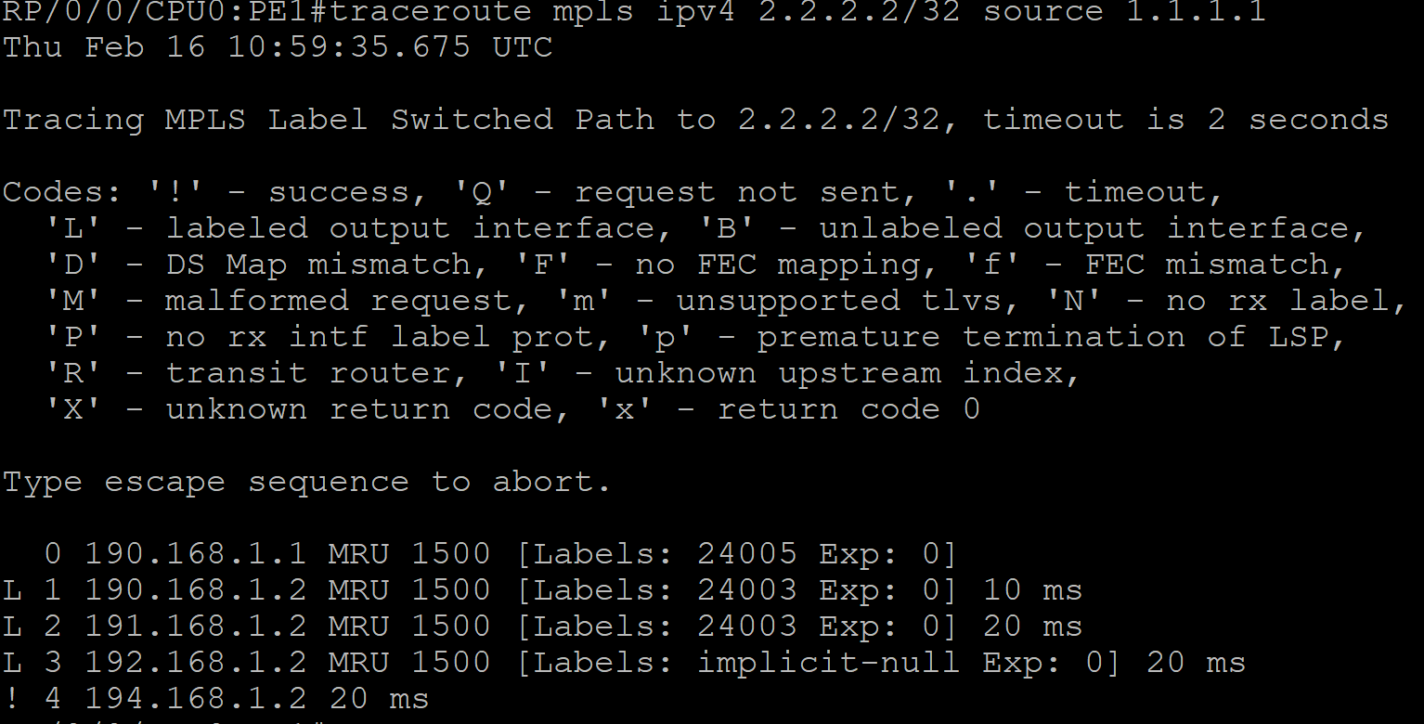




Slide 3
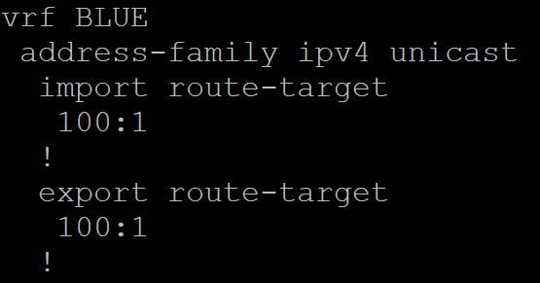
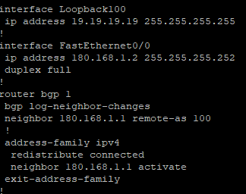
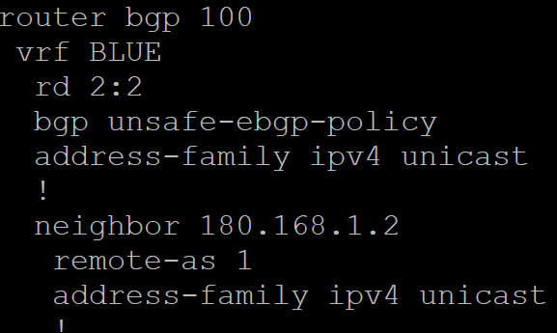


Slide 4

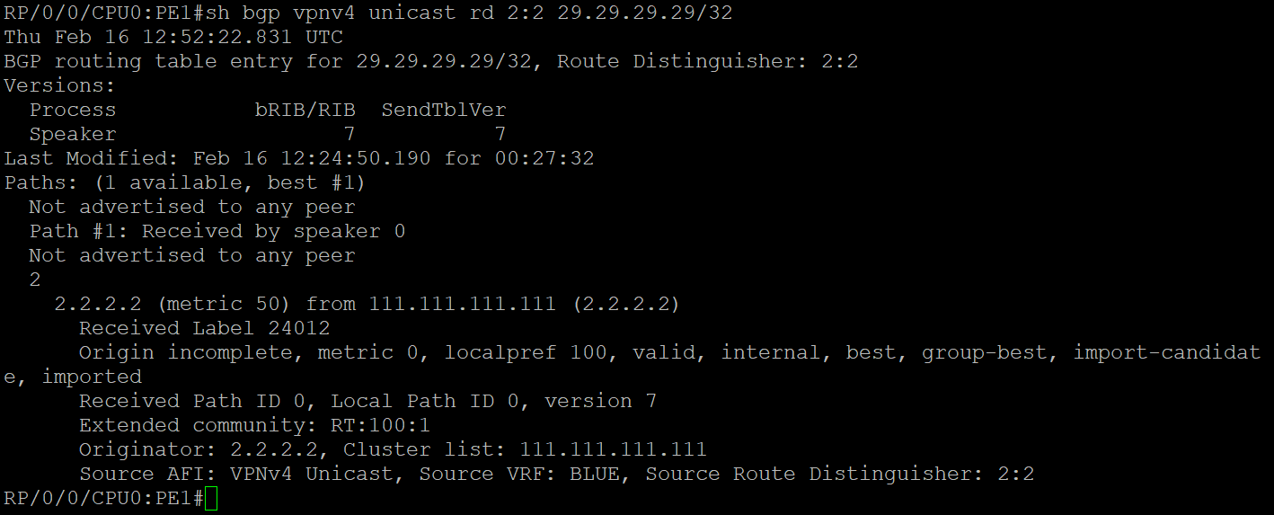
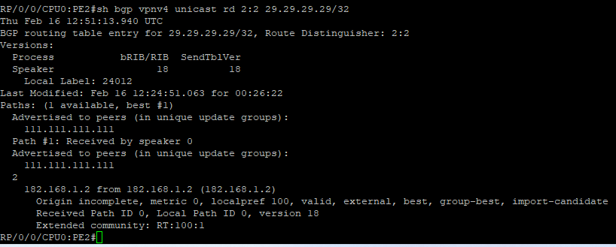

Slide 5



